Slide 1
motivation
There are some HS that are diffusive looking, and some not, but they all mostly bedrock.
Need fig showing some diffusive and some not

Slide 2
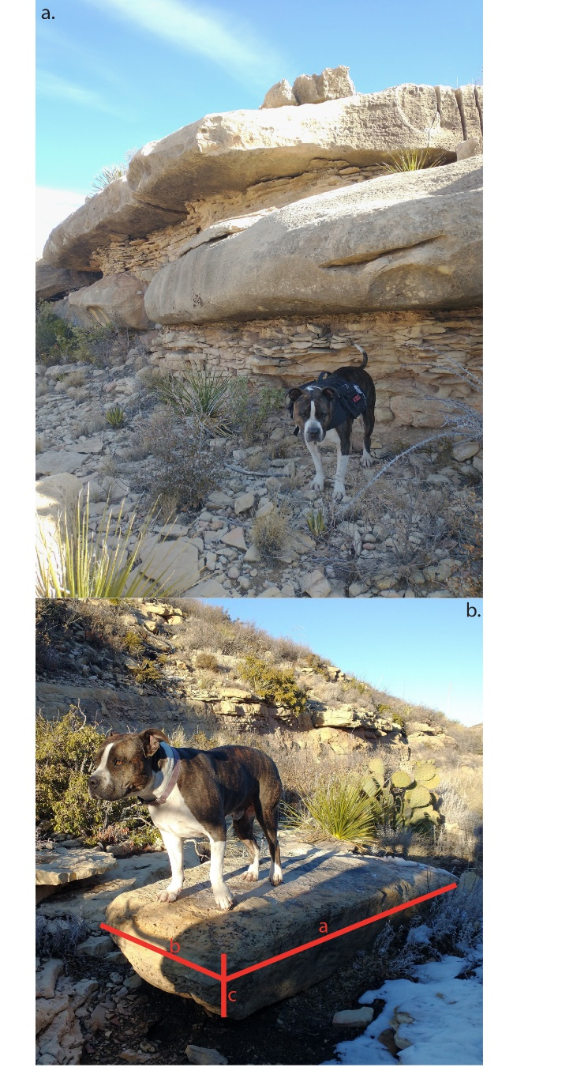
Figure : Field photos showing a) exposed beds of varying thicknesses and b) a boulder in the channel with dimensions reflective of proximal exposed bedrock.

Slide 3
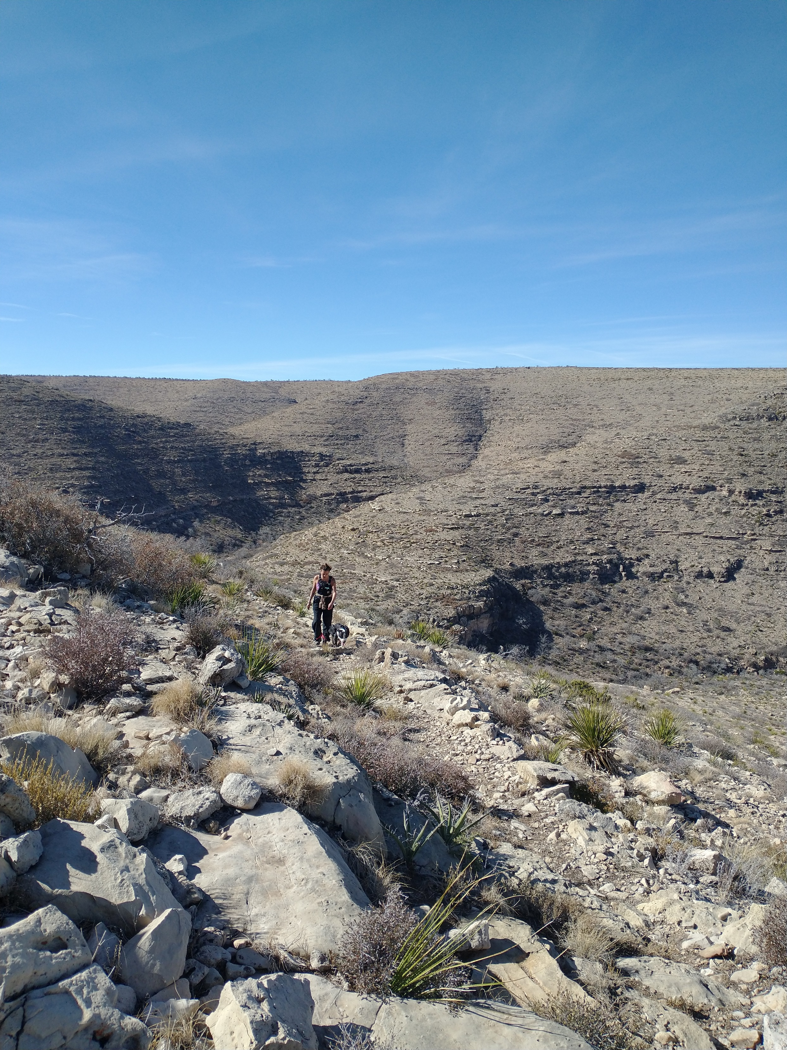
Figure : Field photo highlighting the steep downstream and shallow upstream hillslopes.

Slide 4
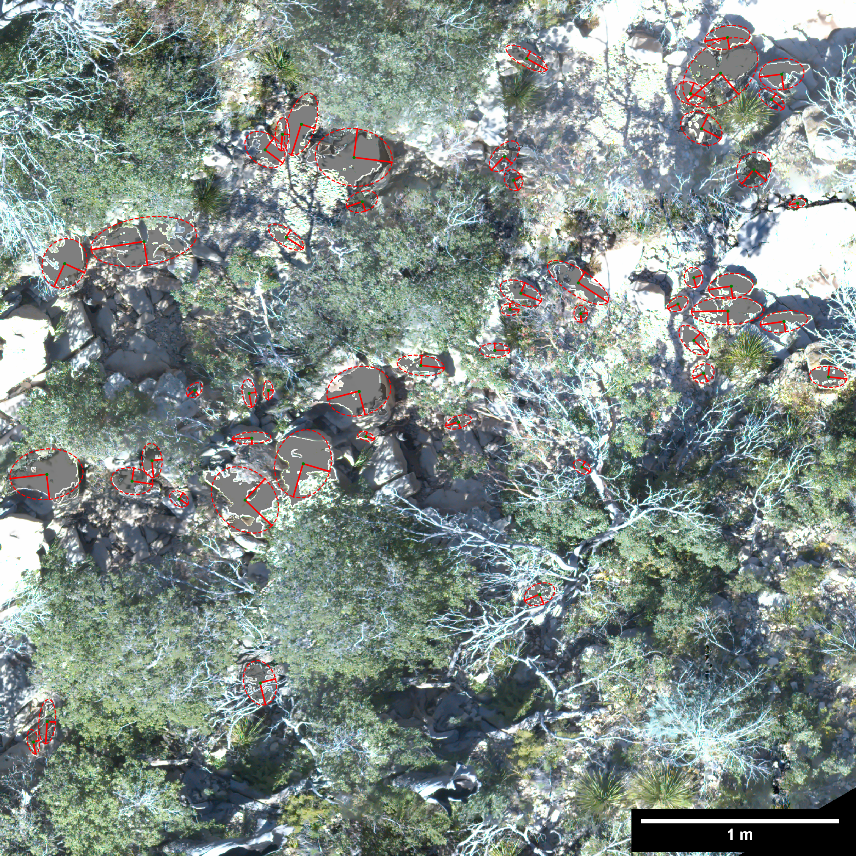
Figure : Orthomosiac illustrating the photosieving methodology used to measure sediment sizes in stream channels below the seven hillslope transects. Each measured sediment grain has an ellipse with the a (longer) and b axis (shorter) shown.

Slide 5
Figure : Figure showing the control that sediment size has on channel skeepness (ksn).

Slide 6
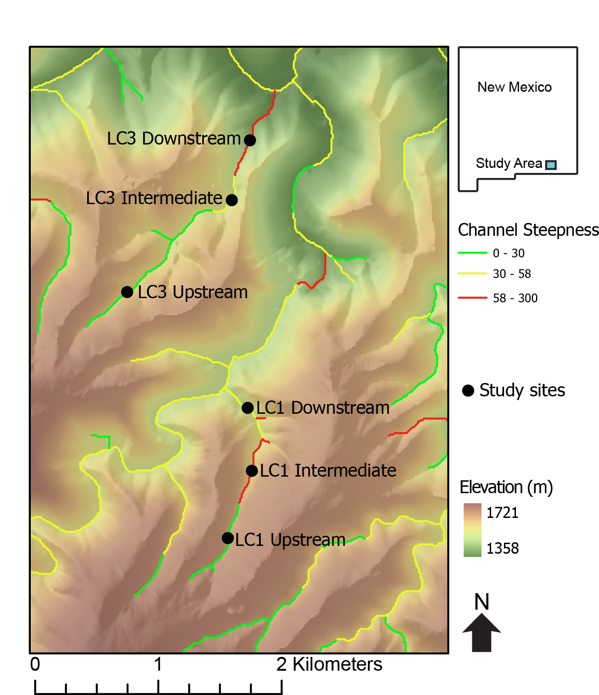
Figure : Topographic map superimposed on a hillshade of Last Chance canyon with ephemeral stream channels. Main stem of channel colored black with arrow indicating the direction of stream flow. The seven hillslope transects in the two different watersheds labeled.
Other LC3 Upstream

Slide 7
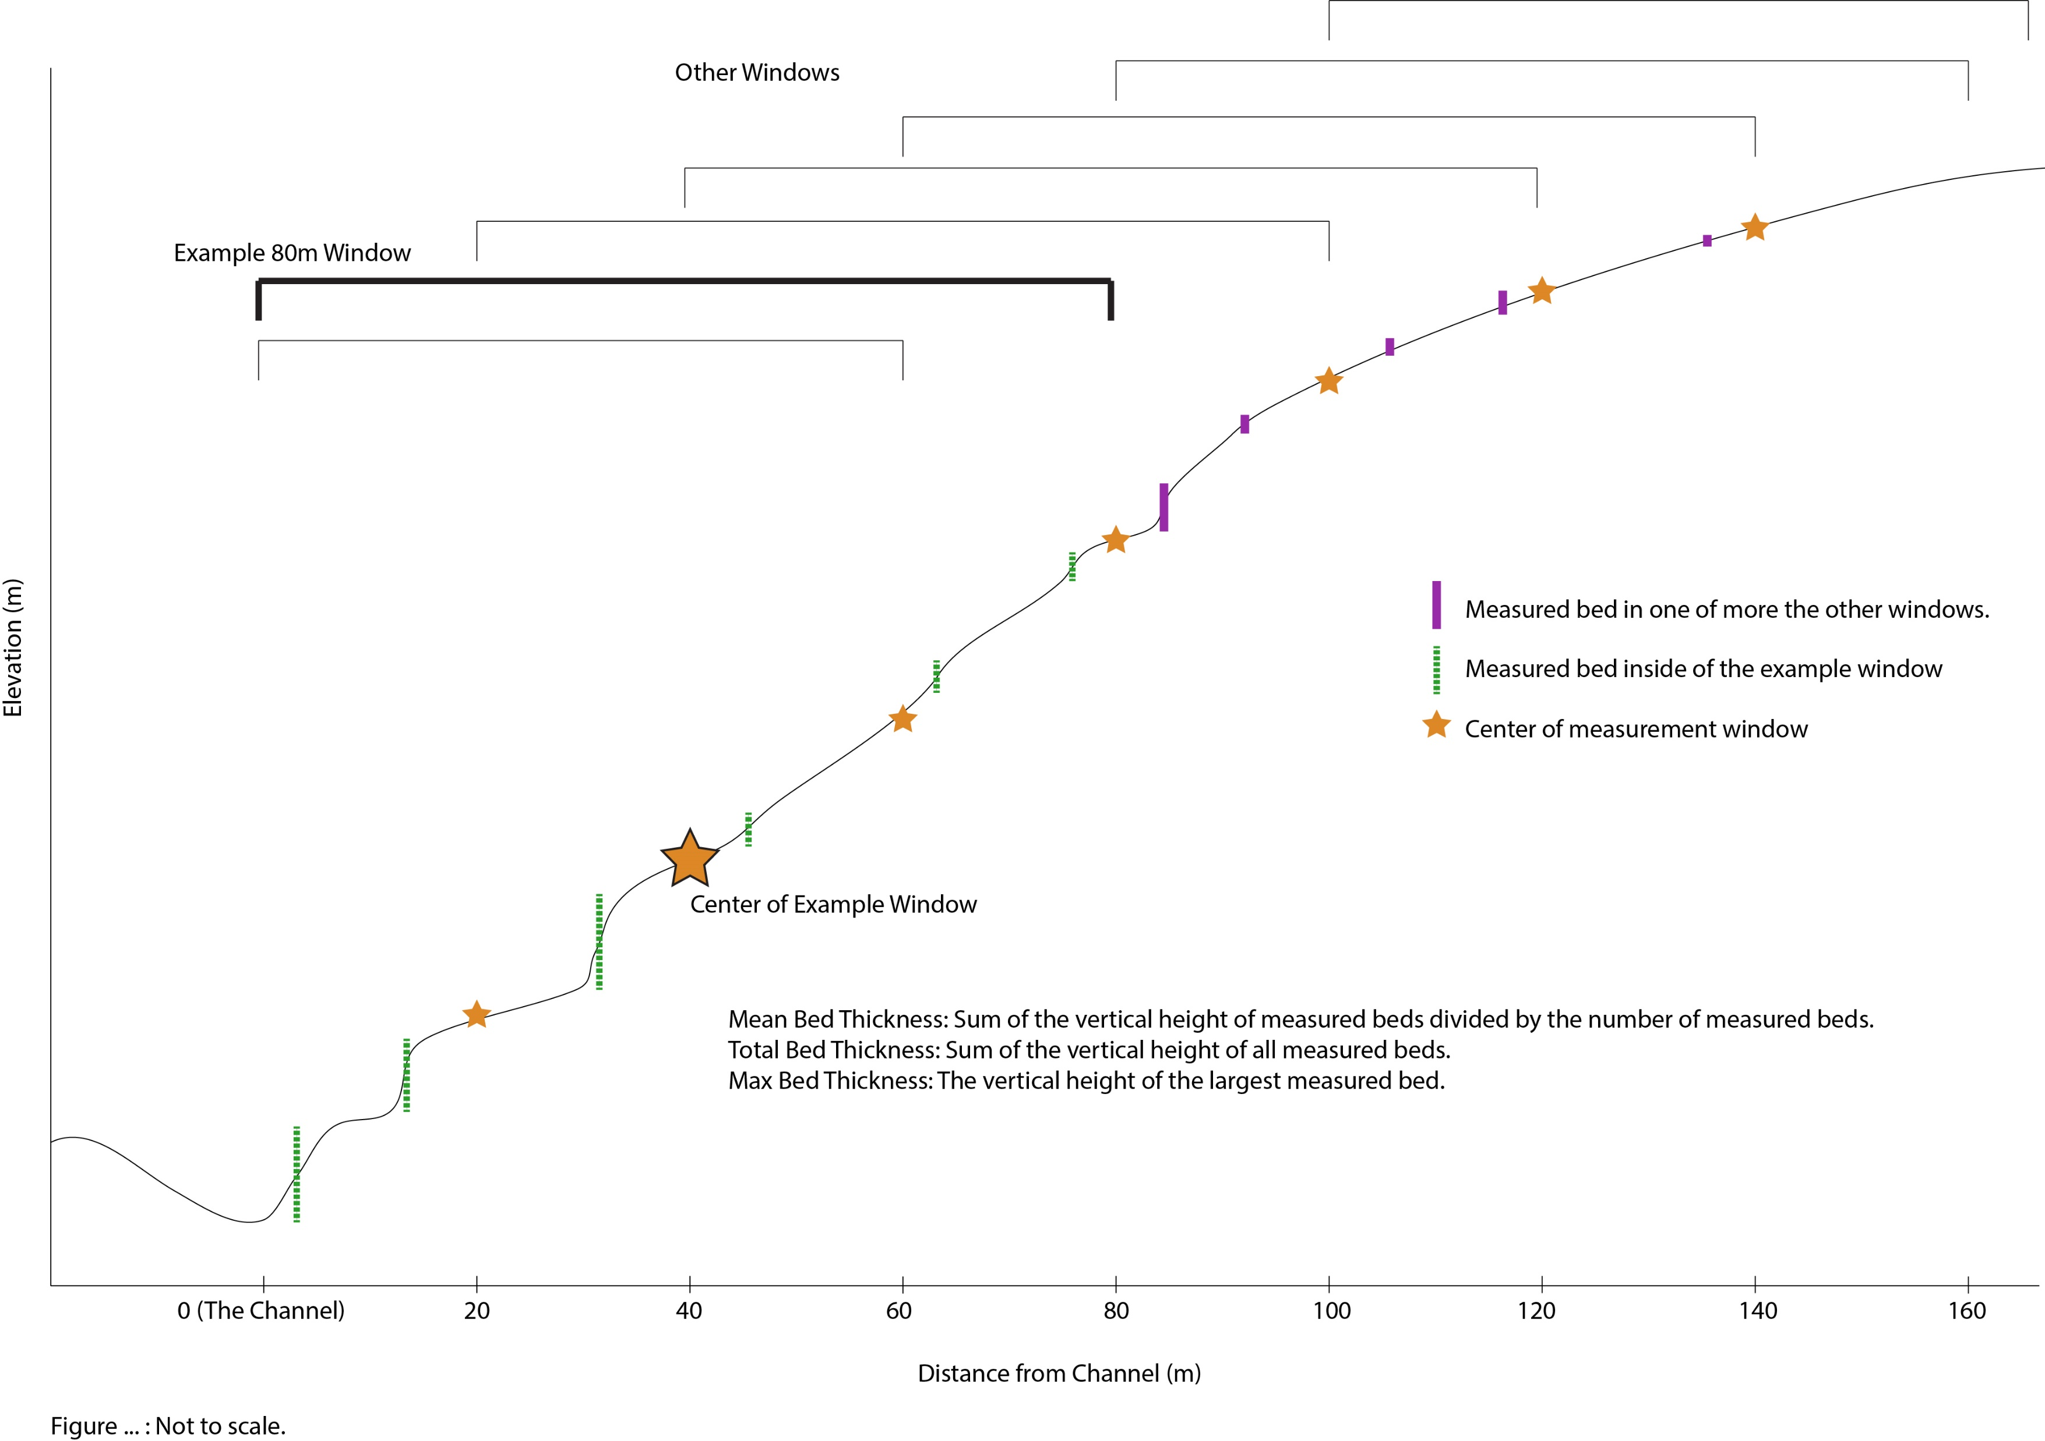
Figure : Schematic (not to scale) demonstrating the 80m window over which both slope and curvature were measured. Note that the 80m window shrinks at the edges of the transect so that data is taken from only the hillslope in question.

Slide 8
Figure : Figure showing the control bed thickness has on slope. Data for both slope and bed thickness are taken over an 80m window. Total thickness is all of the bed heights in he 80m window added together. Mean thickness is the average bed thickness in the window. Max thickness is the vertical distance of the largest bed in the window.

Slide 9
Figure : Chi plots of LC1 - LC5 with exposed bedrock or sediment armored sections mapped. Where known, rock type is shown. To the left of each channel, relevant statistics for each channel are displayed from 1400 - 1550m and above 1550 m. Average boulder volumes, which we measured in the field, above and below 1550 m elevation are shown along with corresponding standard deviations.

Slide 10
Figure : Chi plots of LC1 - LC5 with exposed bedrock or sediment armored sections mapped. Where known, rock type is shown. To the left of each channel, relevant statistics for each channel are displayed from 1400 - 1550m and above 1550 m. Average boulder volumes, which we measured in the field, above and below 1550 m elevation are shown along with corresponding standard deviations.

Slide 11
Figure : Chi plots of LC1 - LC5 with exposed bedrock or sediment armored sections mapped. Where known, rock type is shown. To the left of each channel, relevant statistics for each channel are displayed from 1400 - 1550m and above 1550 m. Average boulder volumes, which we measured in the field, above and below 1550 m elevation are shown along with corresponding standard deviations.

Slide 12
Figure : Chi plots of LC1 - LC5 with exposed bedrock or sediment armored sections mapped. Where known, rock type is shown. To the left of each channel, relevant statistics for each channel are displayed from 1400 - 1550m and above 1550 m. Average boulder volumes, which we measured in the field, above and below 1550 m elevation are shown along with corresponding standard deviations.

Slide 13
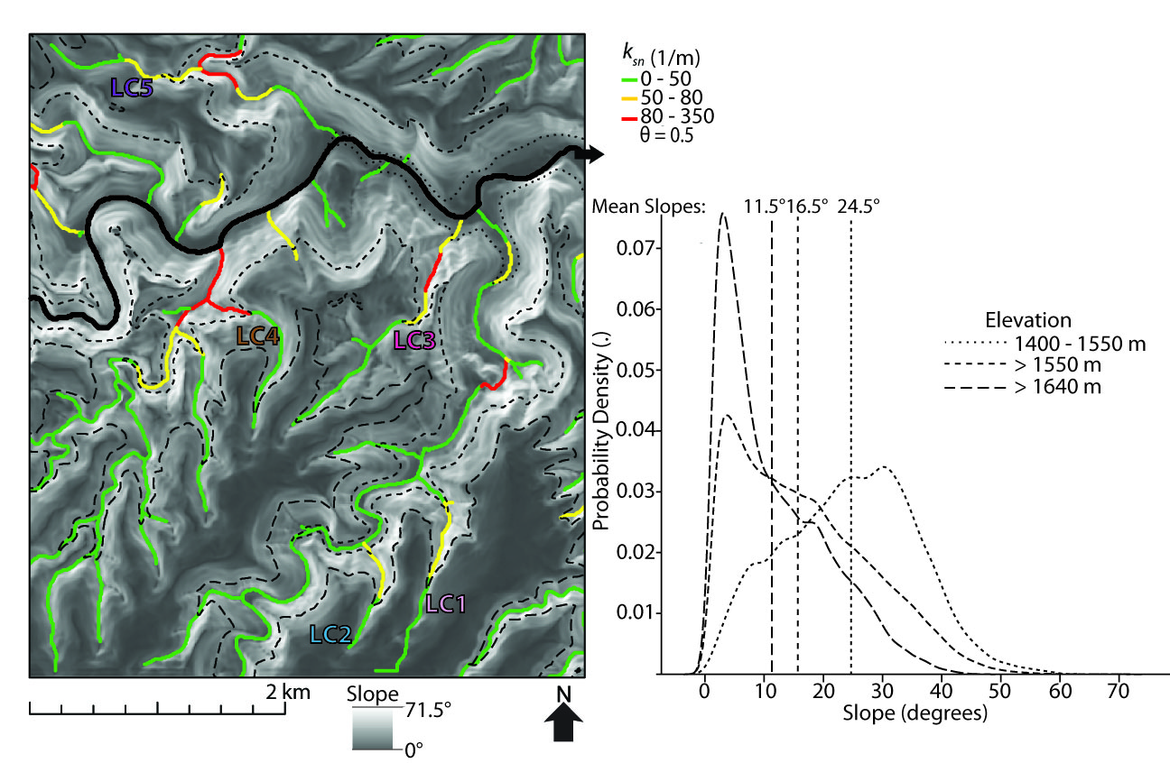

Slide 15
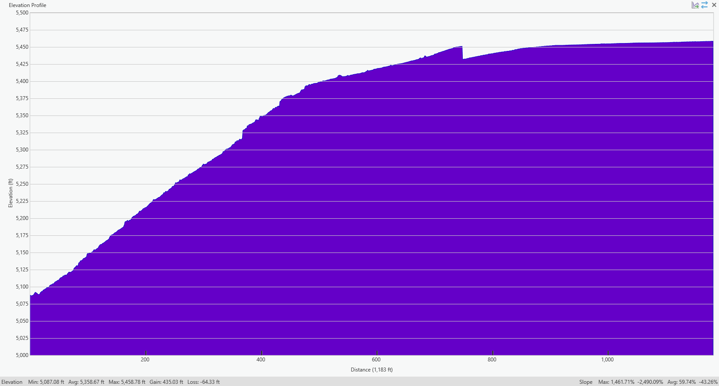

Slide 16
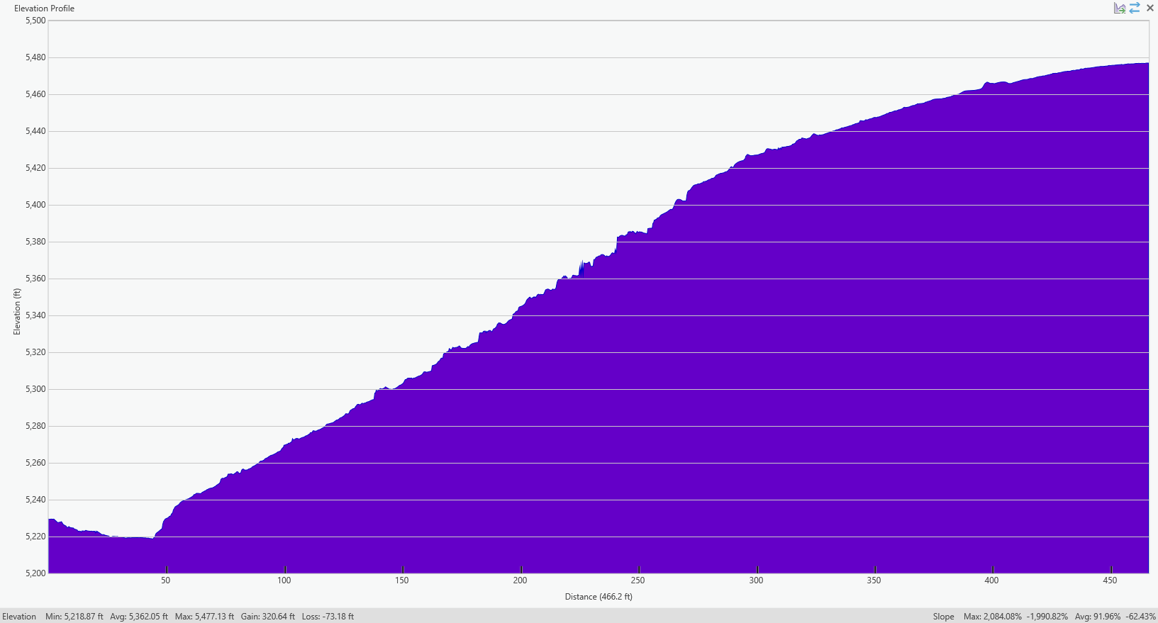
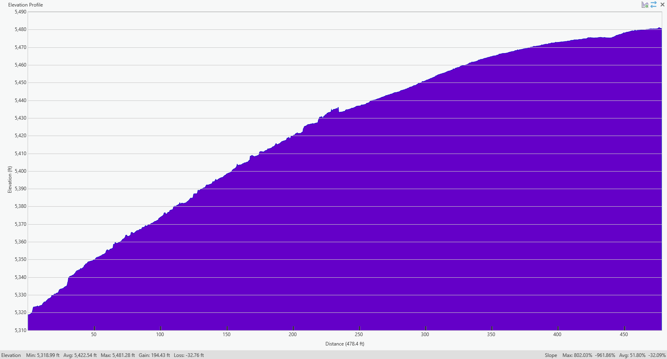

Slide 17
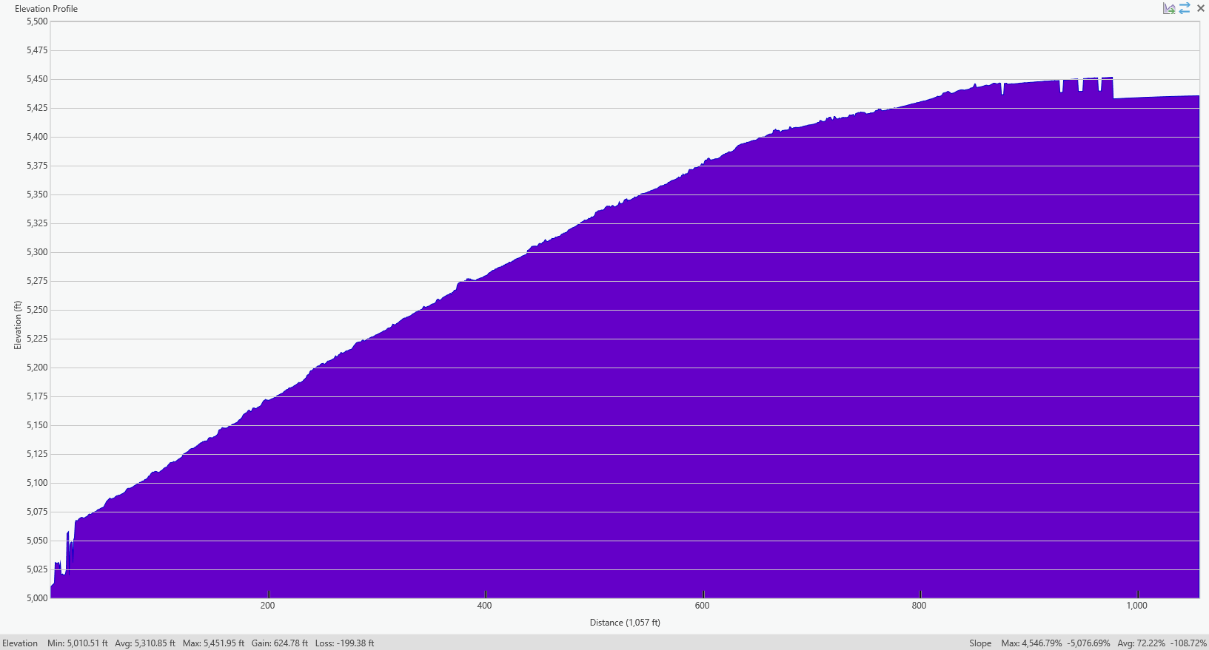

Slide 18
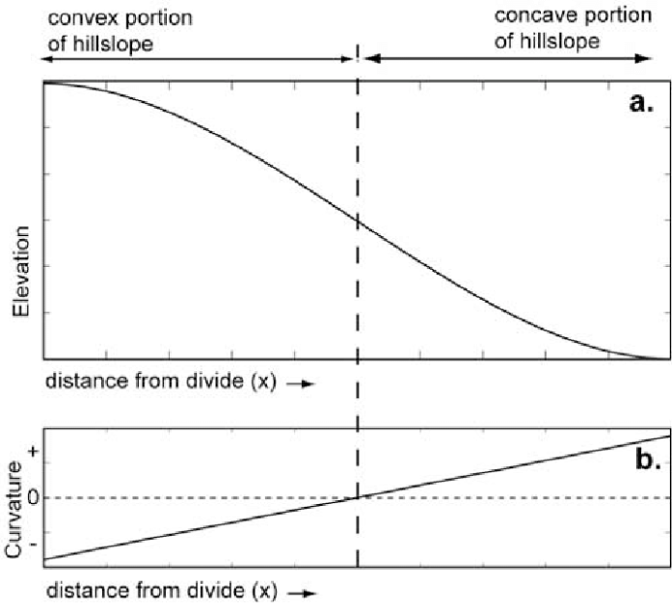
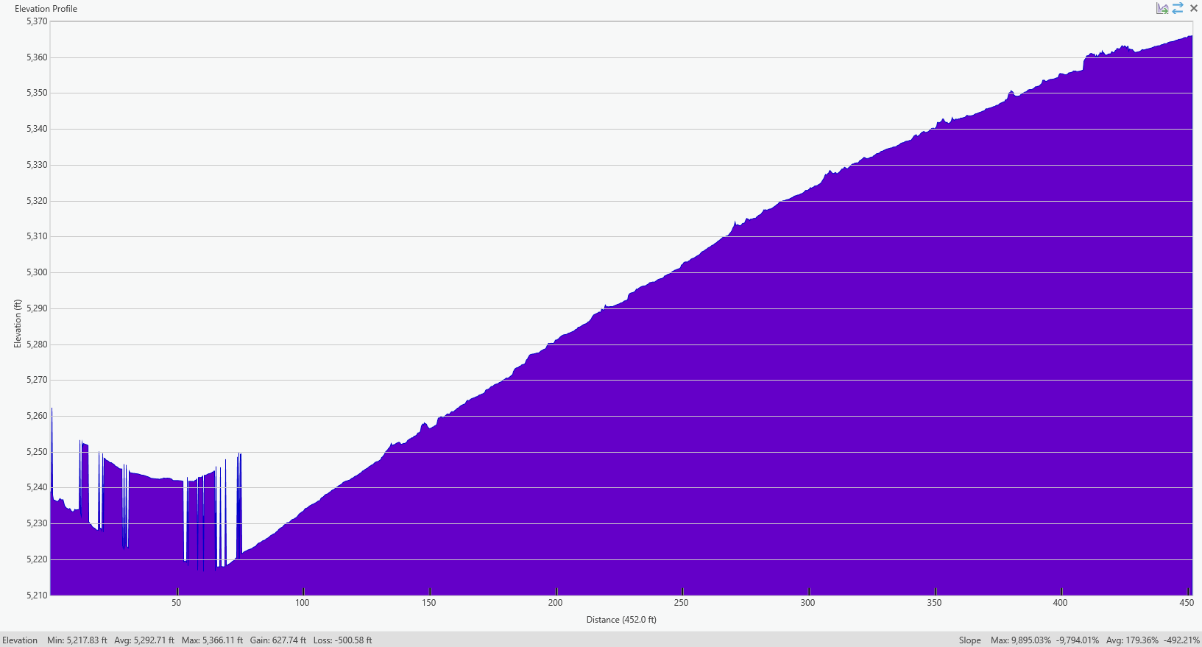
LC3 Shallow 1 is weird

Slide 19
Notes:
Have 3 of the 4 lowest standard deviations in bed thickness, mean bed thicknesses and max bed thickness. The other one is the other shallow transect in LC3. Leads me to believe that shorter beds that are more similar in size cause hillslopes to look “diffuse”.

Slide 20
The plots in the former slide have 3 of the 4 lowest values for standard deviation of bed thickness, mean bed thicknesses and max bed thickness. The other one is the other shallow transect in LC3 (shown below). Leads me to believe that shorter beds that are more similar in size cause hillslopes to look “diffuse”.

